Slide 1
Sentence-Level Extractive Text Summarisation on WikiHow Data
AI6127 Group 1 Members
Abdul Rasyid Sapuan
Andrew Leong Kah Yuan
Glendon Goh Zhi Yi
Kelly Cheng Wen Xin
Zhang Ziyi

Slide 2
Agenda
Introduction
Related Works
Proposed Approach
Experiments
Analysis

Slide 3
Introduction
Text Summarisation is the process of summarising a document into a short and concise version while preserving contextual information. Two main approaches:
Extractive - model selects a subset of words or sentences from the document to summarise it.
Abstractive - model interprets information from the document and generate its own sentences to summarise it.
Motivation:
In the vast ocean of knowledge of the internet, Text Summarisation allows readers to quickly consume articles while keeping vital information.
Objective:
Perform Extractive Text Summarisation at the sentence-level on WikiHow articles. Formulate as a multi-label binary classification problem which predicts which sentence is part of the reference summary.
Notes:
Text Summarisation is the process of summarising a document into a short and concise version while preserving contextual information.
Two main approaches:
Extractive - model selects a subset of words or sentences from the document to summarise it.
Abstractive - model interprets information from the document and generate its own sentences to summarise it.
In the vast ocean of knowledge on the internet, Text Summarisation is important as it allow readers to read an abstract of the article before deciding if they are interested to read the full article in details. This project is motivated from this and aims to perform Extractive Text Summarisation at the sentence-level on WikiHow articles for quicker consumption while keeping vital information.
We will conduct an investigation into how well existing Text Summarization methods perform on WikiHow articles and attempt to improve them by augmenting the said models. It would be interesting to be able to summarise the multi-steps ’how to’ articles into a few key sentences. As the WikiHow articles are written and edited by different authors, the writing styles varies which makes this dataset challenging.

Slide 4
Data - WikiHow
Data¹ consists of ~200,000 articles and has 2 different types:
i) Describe single-method tasks in different steps
ii) Describe multiple steps of different methods for a task
Each article consists of multiple paragraphs and each paragraph starts with a sentence summary.
Data has label to indicate which sentence is part of the referenced summary.
Data is split into 93% training, 3.5% validation and 3.5% test set.
¹ https://transformersum.readthedocs.io/en/latest/extractive/datasets.html#wikihow
Notes:
The WikiHow dataset contains over 200,000 articles and has 2 different types:
1. Describe single-method tasks in different steps
2. Describe multiple steps of different methods for a task.
Each article consists of multiple paragraphs and each paragraph starts with a sentence summary.
Since for this project we are performing Extractive Summarization, the modified dataset we used is
taken from TransformerSum website [8].
Data is labelled to indicate which sentence is part of the referenced summary

Slide 5
Related Works
MatchSum
modified Siamese-BERT model
semantic matching-based summarization
all-MiniLM-L6-v2 (Sentence Transformer)
BERT-based
Outputs a 384-dimensional embedding
all-distilroberta-v1 (Sentence Transformer)
RoBERTa-based
Outputs a 768-dimensional embedding
Notes:
MiniLM-L6 is a smaller version of MiniLM-L12-H384-uncased
Regular transformers produces word embeddings, a pooling layer is added on top of this to combine these word embeddings to product sentence embeddings.
Various pooling methods can be used such as mean or max pooling.
Example: A sentence is fed into a regular transformer and the output is passed onto the pooling layer which then outputs the sentence embedding

Slide 6
Evaluation Criteria
Recall-Oriented Understudy for Gisting Evaluation (ROUGE) is used to measures the quality of the system summary against a reference summary. Scale to range [0, 100], the higher the score the better.
Evaluation Metrics used:
ROUGE-1: Overlap of unigram (each word) between the system and reference summaries.
ROUGE-2: Overlap of bigrams between the system and reference summaries.
ROUGE-L: Measure longest matching sequence of words using Longest Common Subsequence (LCS) between two sentences.

Slide 7
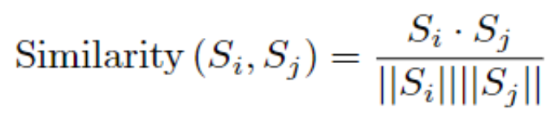
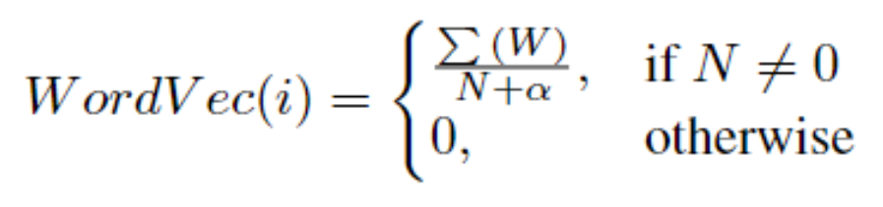
Baseline - TextRank
TextRank summarises text at the sentence-level.
Ranks sentences by how representative they are of the document
Evaluated using similarity score between sentences
Each sentence vector is represented by arrays of word vectors

Slide 8
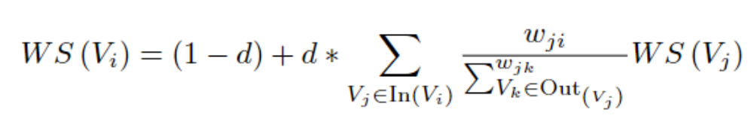
Baseline - TextRank
Similarity matrix is converted into a weighted graph
Each vertex represents a sentence
Edge between two vertices represents the similarity between the corresponding sentences.
Ranking computed using PageRank algorithm
Top 4 sentences with the highest PageRank score are selected as summary (if article has less than 4 sentences, all are included in summary)

Slide 9
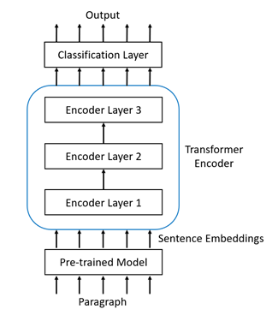
Proposed Approach (PTX-Sum)
Pre-trained eXtractive Summarizer (PTX-Sum):
Use sentence embeddings from pre-trained models
Added classification layer on top of transformer encoder
Encoder parameters
3 Layers
4 Attention heads
10,255,568 / 24,028,496 Total parameters

Slide 10
Proposed Approach (PTX-Sum)
Used sentence embeddings from 2 different pretrained models
all-MiniLM-L6-v2
all-distilroberta-v1
Training parameters:
10 epochs
20,000 random samples per epoch
Adam Optimizer, 1e-4 learning rate
Binary-Cross Entropy loss function.
Training time ~3-4 hours

Slide 11
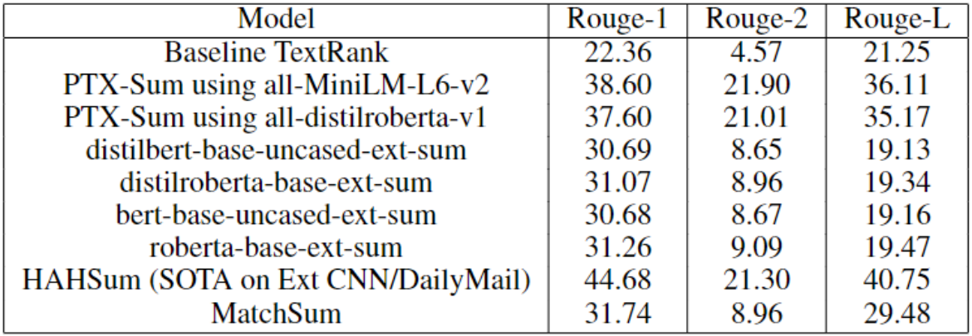
Experiment Results
Picked the top 4 sentences with the highest probability from the model output.
Compared with TextRank as a baseline and also other models.
Notes:
PTX-Sum using all-MiniLM-L6-v2 performs the best followed by PTX-Sum using all-distilroberta-v1

Slide 12
Analysis
Pros:
Pre-trained sentence transformers trained on large & diverse datasets
Reddit comments, Yahoo Answers, WikiHow, SQuAD2.0, etc.
Totalling 1 billion sentence pairs.
Able to get embeddings that capture contextual information well.
Cons:
Reliant on pre-trained sentence transformers.
In the absence of suitable pre-trained models for the context, long computation time is required to train our own model from scratch.
Each pre-trained model has its own limitations based on the sequence-length (number of sentences) of the paragraph. Long paragraphs may face issues in the encoding of the sentences if they cannot be trimmed down.

Slide 13
Conclusion
PTX-Sum using all-MiniLM-L6-v2 performs the best followed by PTX-Sum using all-distilroberta-v1
(Pros) Can exploit the available pre-trained sentence which capture contextual information well.
(Cons) Reliant on pre-train sentence transformer and subjected to similar context

